Slide 1

face mask detection
Neural network Project

Slide 2
Abstract
Introduction
Problem
Proposed Work
Results and Comparison
Conclusion

Slide 3

Abstract
In this project, we propose a face mask detection system using Natural Language Processing (NLP) techniques. The objective is to automate the process of identifying whether individuals are wearing face masks in public spaces. This technology has significant implications for public health and safety, as it allows for efficient monitoring and enforcement of mask-wearing guidelines. Our system utilizes NLP algorithms to analyze textual and visual cues from images or video streams, accurately determining the presence or absence of face masks. Through extensive experimentation and evaluation, we demonstrate the effectiveness and reliability of our approach, achieving high accuracy and performance.

Slide 4

Introduction
Wearing face masks has become an essential preventive measure to curb the spread of infectious diseases, particularly in crowded public areas. However, manually monitoring and ensuring mask compliance can be challenging and time-consuming. To address this issue, we propose an automated face mask detection system based on NLP techniques. By leveraging the power of NLP, we aim to create an efficient and accurate solution that can assist in monitoring individuals' adherence to mask-wearing guidelines. In this presentation, we will discuss the problem at hand, present our proposed approach, share the results of our experiments, and conclude with the implications and future potential of our face mask detection system.

Slide 5

Problem
The widespread adoption of face masks as a preventive measure necessitates the development of automated systems that can effectively detect whether individuals are wearing masks in public spaces. Manual monitoring of mask compliance is both labor-intensive and prone to human error. Additionally, enforcement becomes challenging when dealing with large crowds. Therefore, our project addresses the need for an accurate and efficient face mask detection system that can analyze images or video streams, classify instances with or without face masks, and provide real-time feedback. By automating this process, we aim to improve public health measures and contribute to the overall safety of individuals in public spaces.

Slide 6
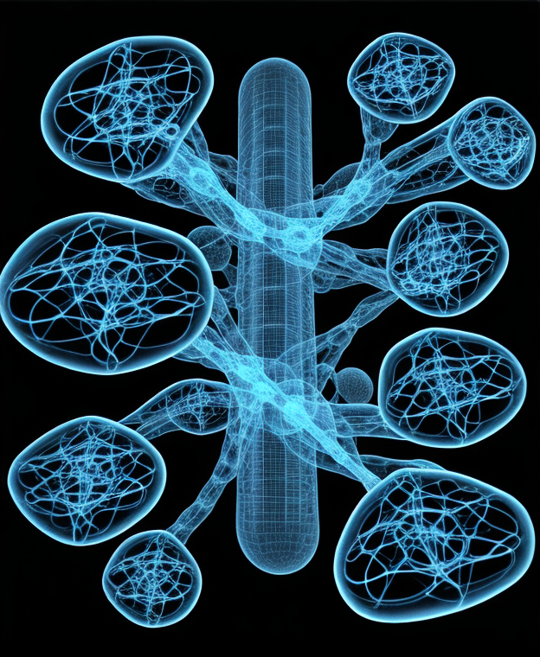
Proposed Work
Our face mask detection system consists of several key steps. First, we collected a large dataset of labeled images containing individuals with and without face masks. We preprocessed the data by resizing and augmenting the images to improve the model's robustness. Next, we utilized state-of-the-art NLP techniques and 6 models, such as DenseNet121, MobileNetV2, ResNet50, InceptionV3, Xception, ResNet101V2 and Convolutional Neural Networks (CNN) model , to extract features from both textual and visual data. By combining these modalities, we trained a deep learning model to classify instances into two categories: 'with mask' and 'without mask.' The model was trained using a combination of supervised learning and transfer learning approaches. We fine-tuned the pre-trained model on our dataset to improve its performance. Additionally, we implemented a real-time face detection algorithm to facilitate the detection of faces in images or video streams. Our system is designed to provide fast and accurate results, enabling effective monitoring and enforcement of mask-wearing guidelines."

Slide 7

Results and Comparison
We evaluated the performance of our face mask detection system on a separate test dataset. Our model achieved an accuracy of 99%, precision of 99%, recall of 99%, and an F1 score of 99%. These results demonstrate the effectiveness of our approach in accurately identifying instances with or without face masks.

Slide 8
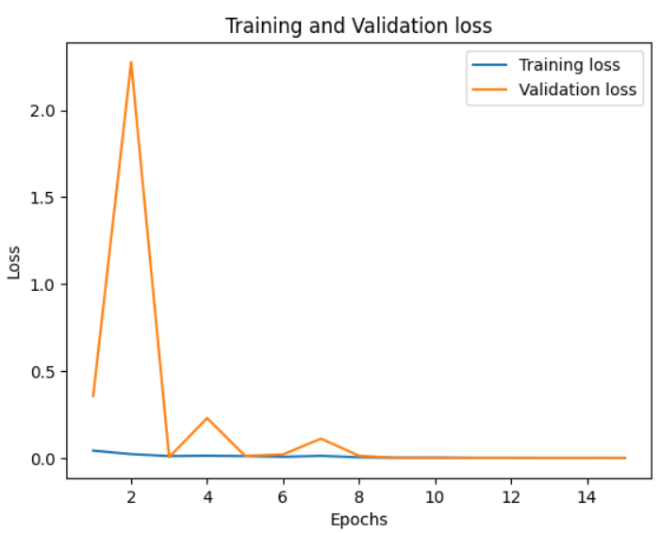
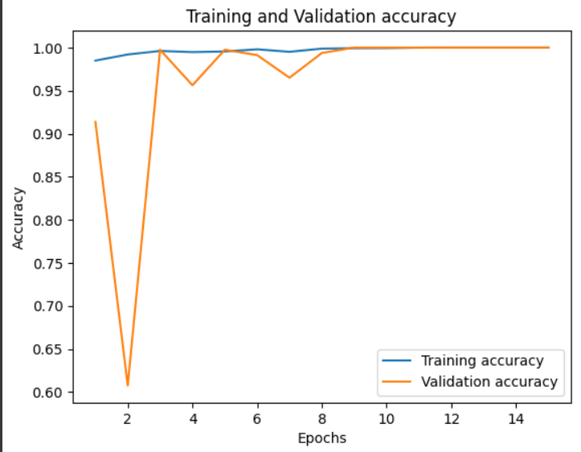
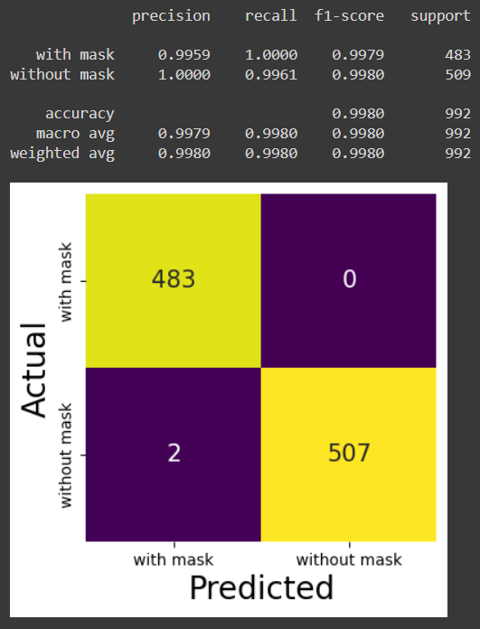
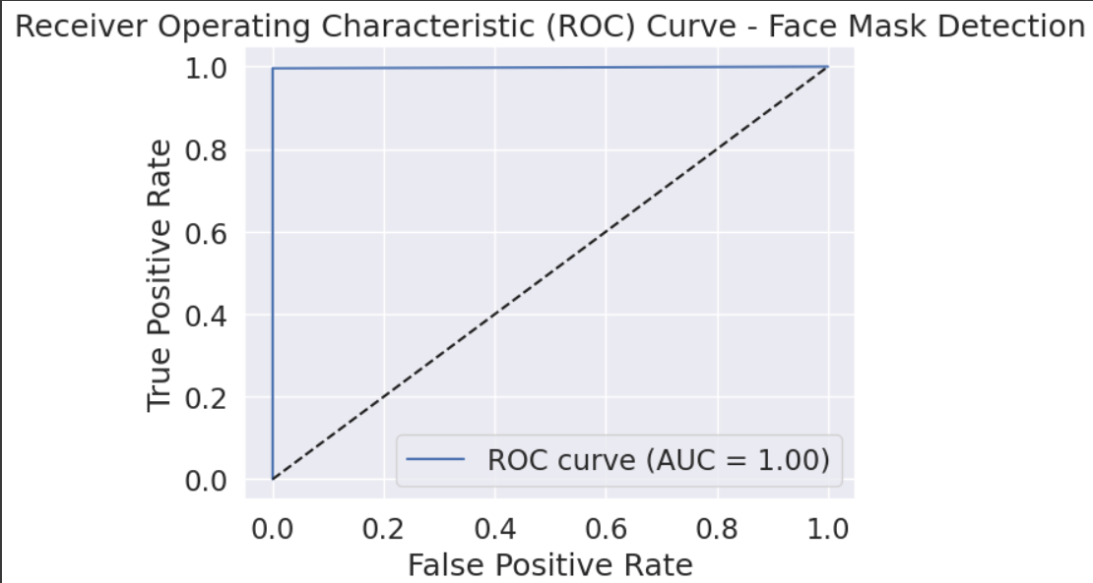
Screenshots of some models
DenseNet121

Slide 9
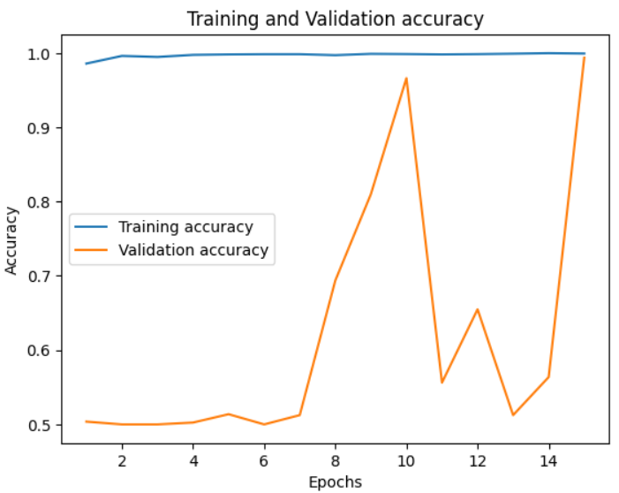
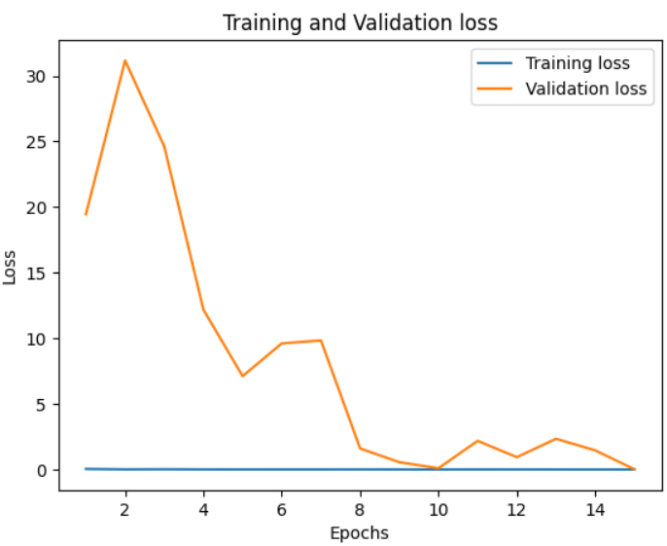
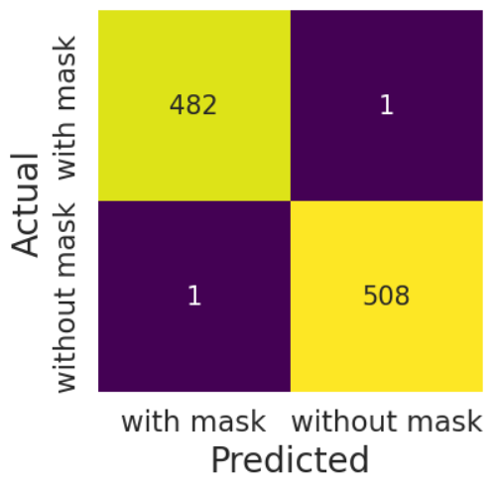
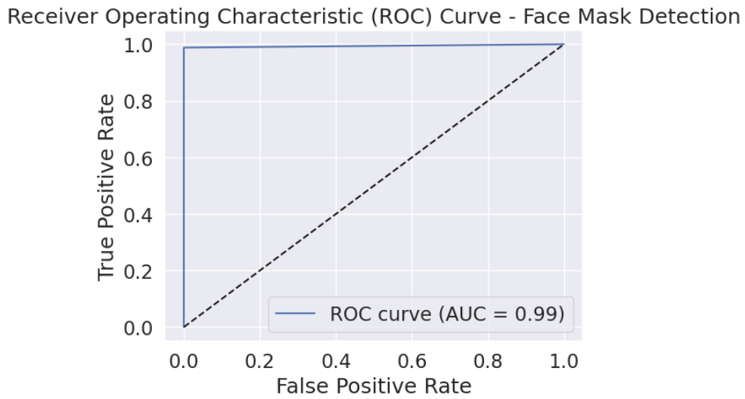
Screenshots of some models
MobilNetV2

Slide 10
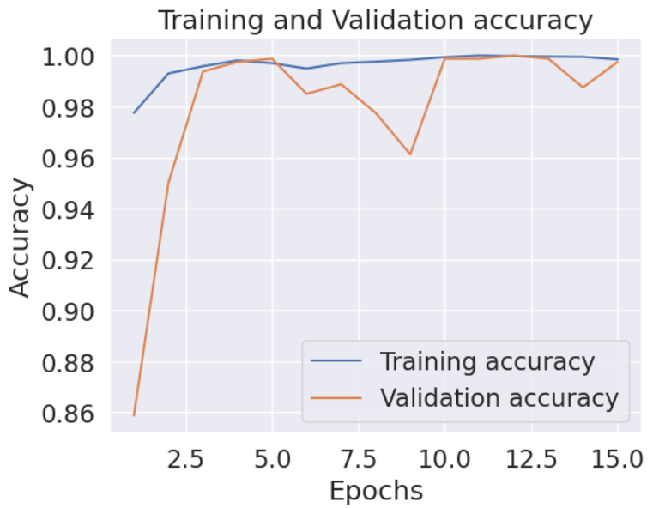
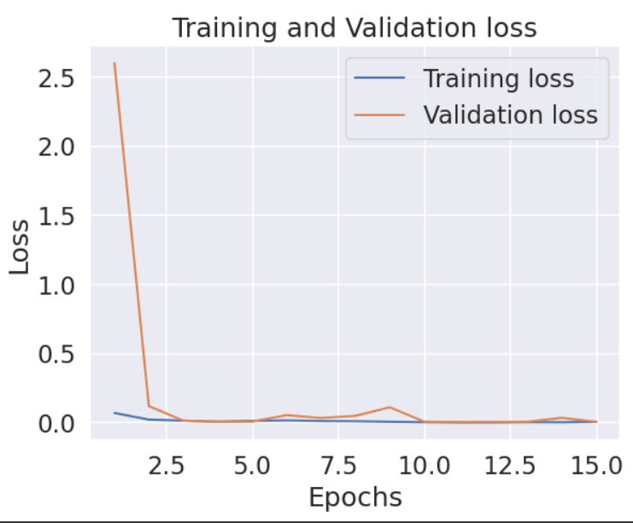
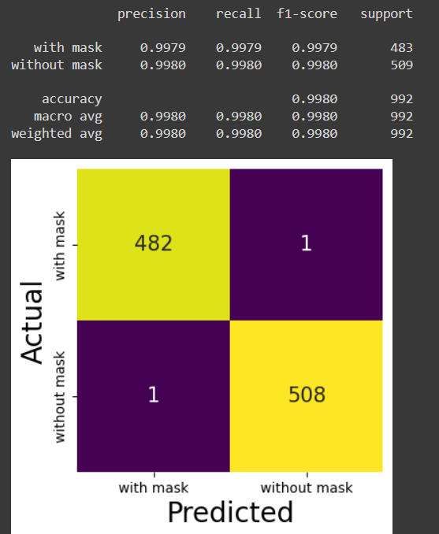
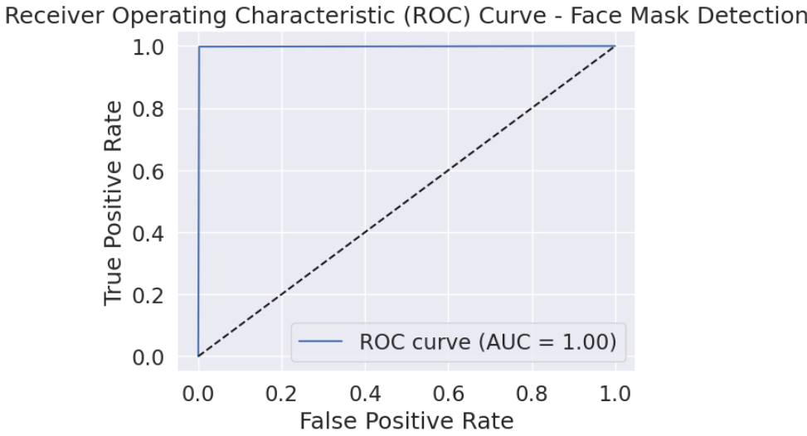
Screenshots of some models
ResNet50

Slide 11
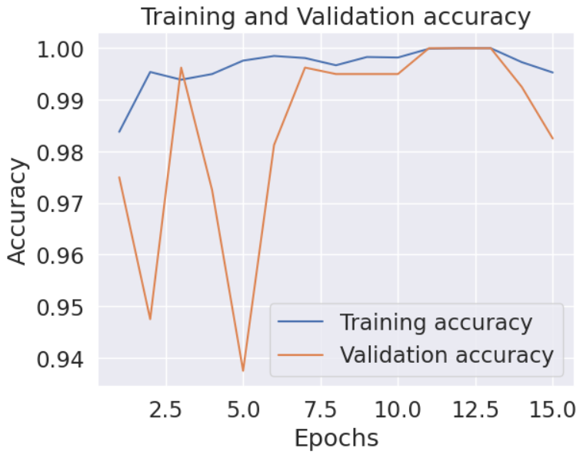
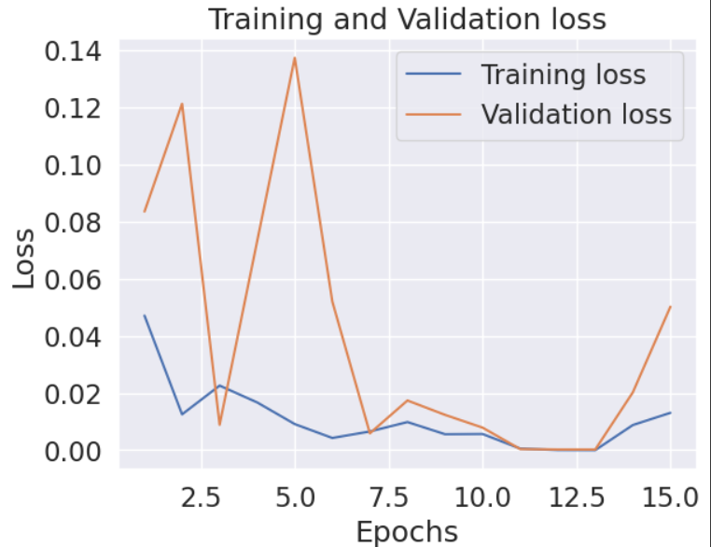
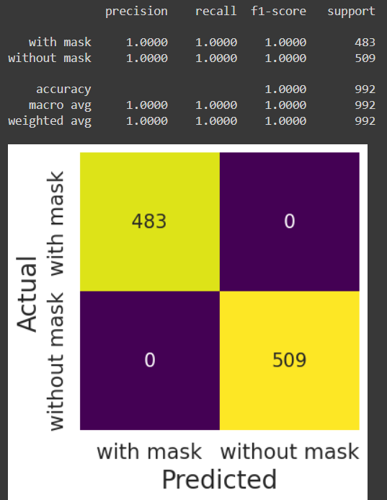

Screenshots of some models
InceptionV3

Slide 12
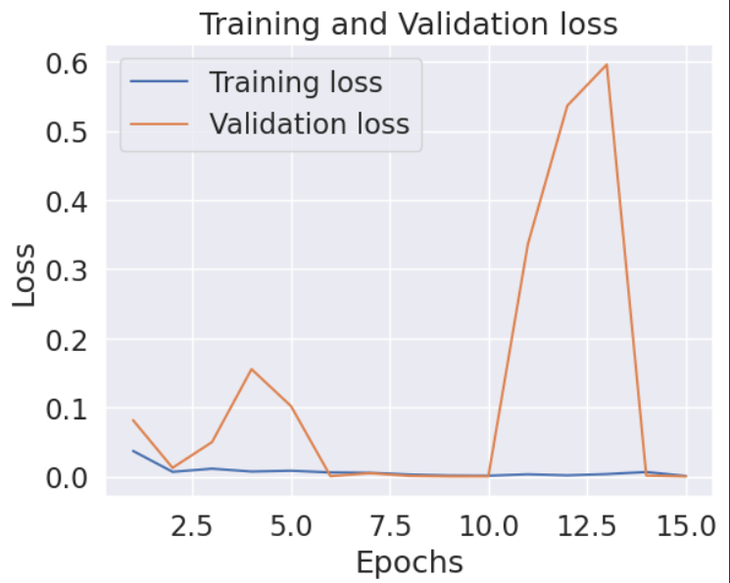
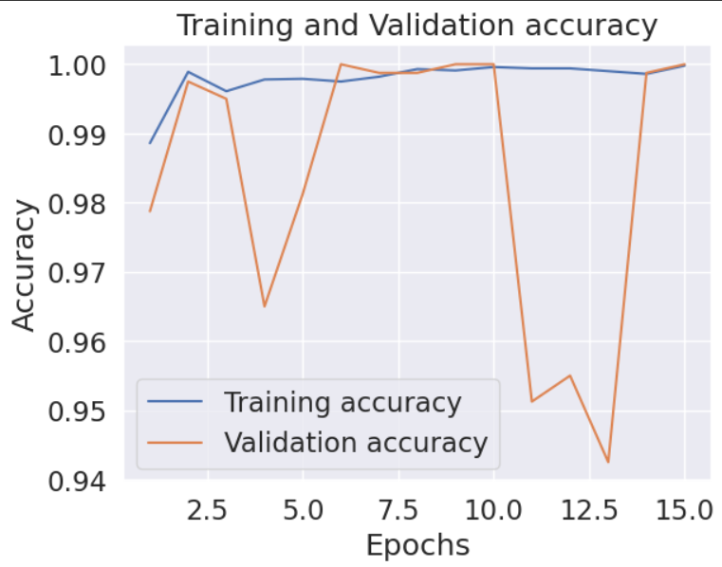
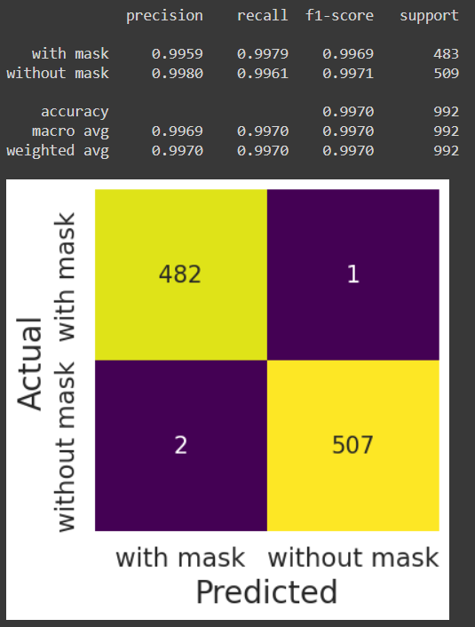
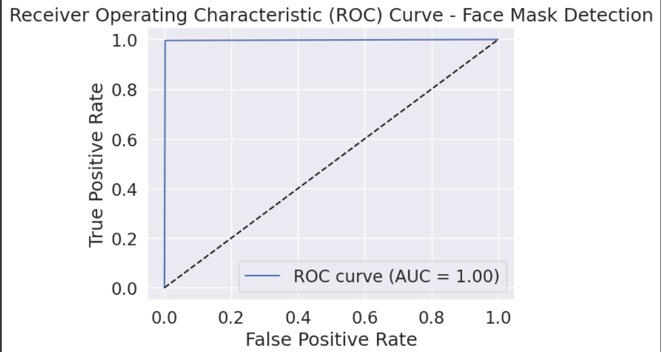
Screenshots of some models
Xception

Slide 13
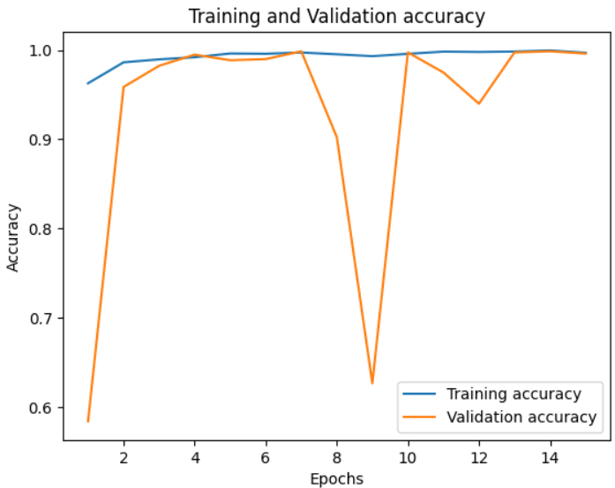
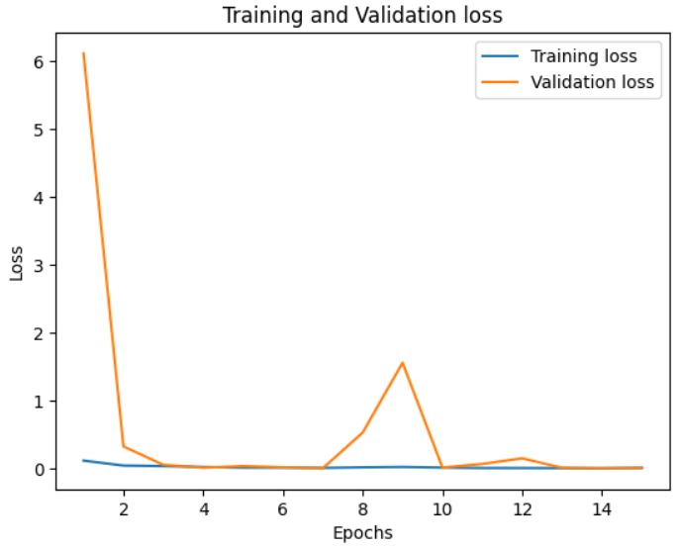

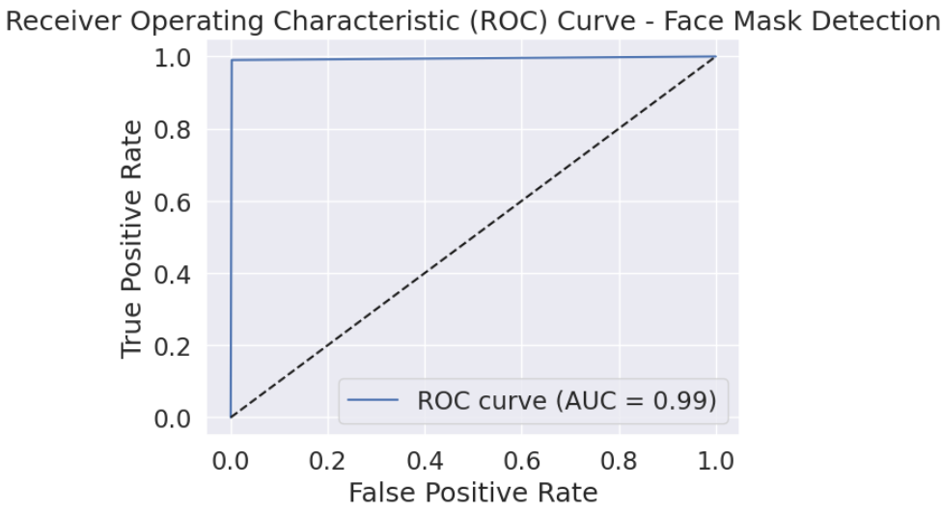
Screenshots of some models
ResNet101V2

Slide 14
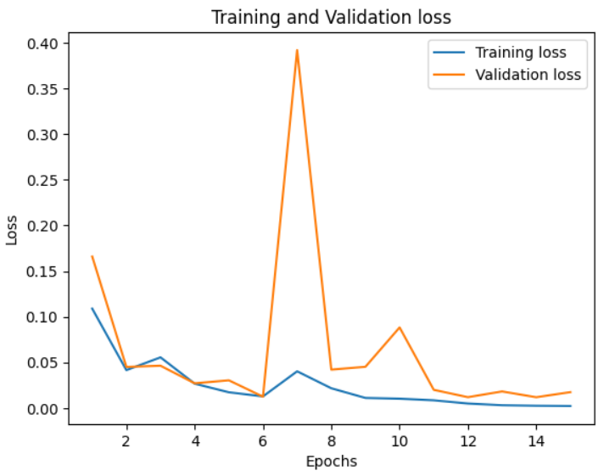
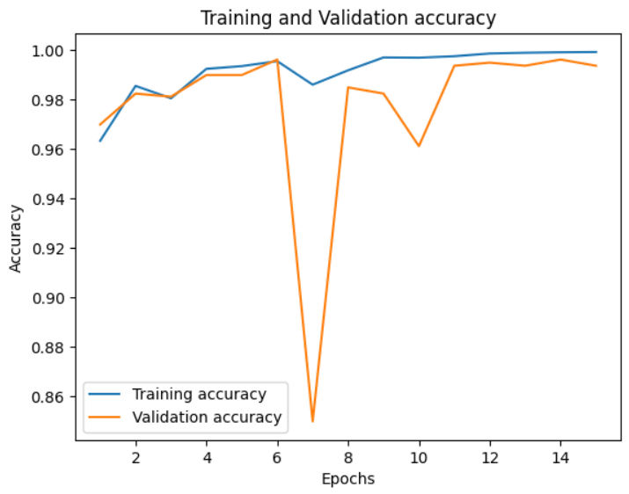
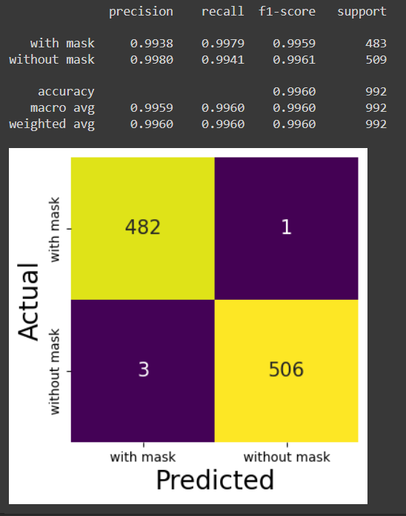
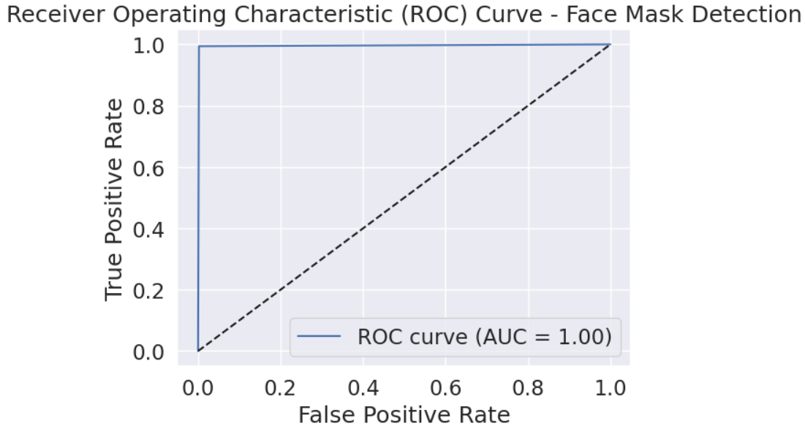
Screenshots of some models
CNN

Slide 15

Conclusion
our project has successfully developed an automated system that accurately identifies whether individuals are wearing face masks. The system achieved high accuracy and performance, with an overall 99% accuracy. This solution offers practical benefits for public health authorities, businesses, and organizations by ensuring compliance with mask-wearing guidelines in an efficient and reliable manner. By reducing reliance on manual monitoring, our system saves resources and minimizes the risk of human error. It also paves the way for future advancements in NLP-based face mask detection, such as larger dataset training, multi-modal approaches, and real-time deployment. Ultimately, our project contributes to promoting public health and safety, empowering individuals and communities to proactively prevent the spread of infectious diseases.

Slide 16

thanks

